Slide 1

Introduction to Operating Systems CS/COE 1550
Spring 2020-2021
Sherif Khattab
ksm73@pitt.edu
(Some slides are from Silberschatz, Galvin and Gagne ©2013)

Slide 2
Announcements
Upcoming deadlines:
4/22: Homework 12
4/23: Lab 5
4/26: Project 4 (File System)
5/2: Quiz 4
Tophat questions due one week after each lecture
OMETs
1 bonus point when response rate >= 80%
currently 26-27%

Slide 3
Last Lecture …
File System Implementation
Optimizing performance
sector interleaving
i-node grouping
log-structured file system
CD-ROM and SSD issues

Slide 4
Muddiest Points
For the final, will it be the same as the midterm and only cover the material after the midterm?
Is there a scenario to use sector interleaving now ?
how does sector interleaving increase performance?
grouping data on disk slide
What is a cylinder group?
Flash Disks
wear leveling
Why does preventing writing 0s to 1s give better performance
Why does flash file system work?
A visual of wear leveling
sector implementation: what kinds of structures/logic would this involve?
Log-Structured File Systems
What is the advantage of log structured file systems besides keeping old versions of files?
does using the log structured file system lower disk utilization?

Slide 5
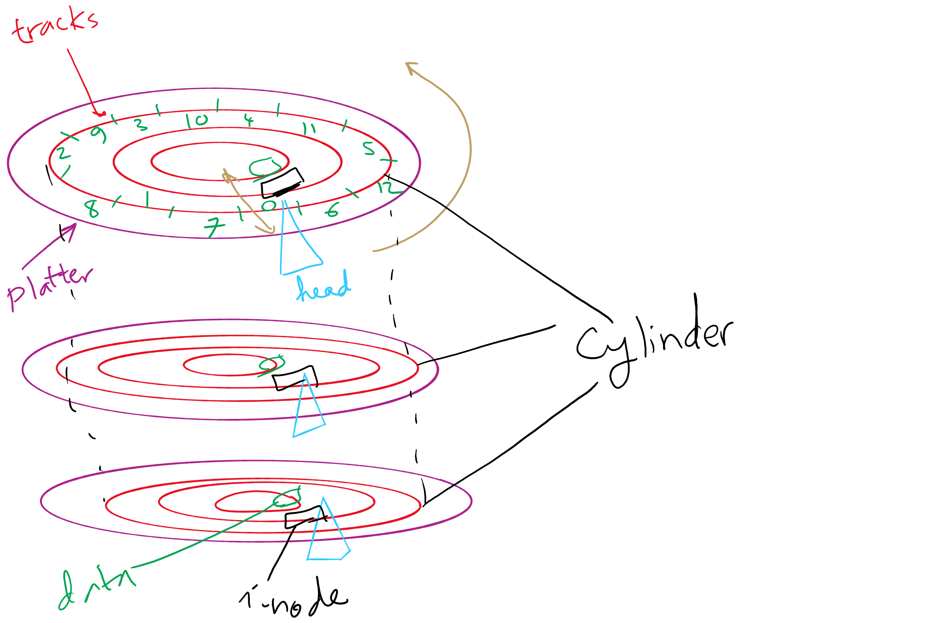
Disks, cylinders, cylinder groups

Slide 6
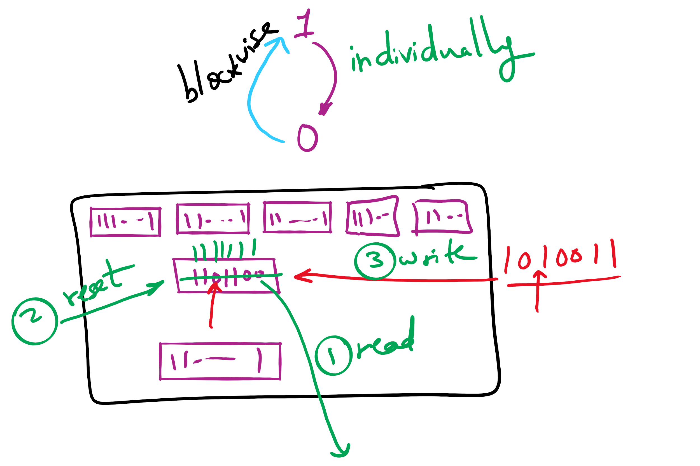
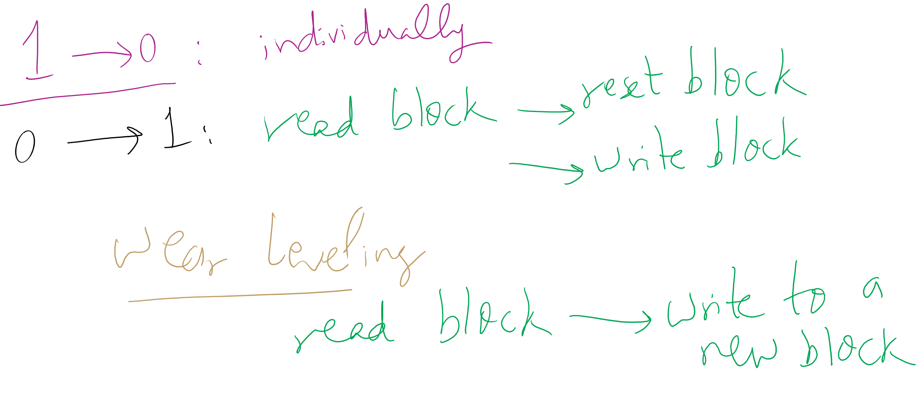
Wear leveling for SSDs

Slide 7
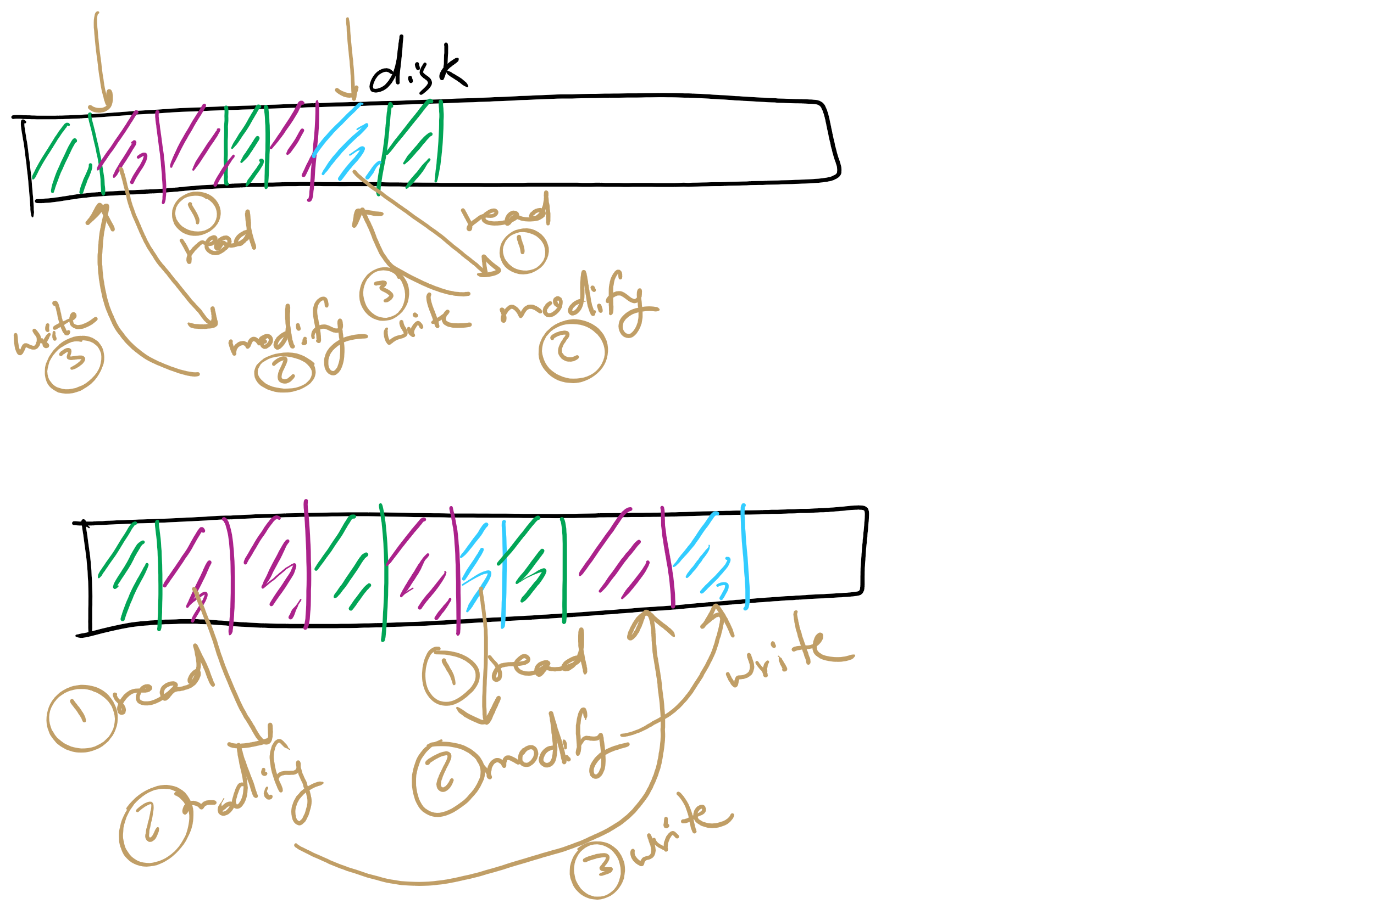
Log Structured File System

Slide 8
Today’s Agenda …
Low-level device driver issues
memory-mapped vs port-mapped I/O
3 Ways to read/write from an I/O Device
Disk structure and scheduling

Slide 9
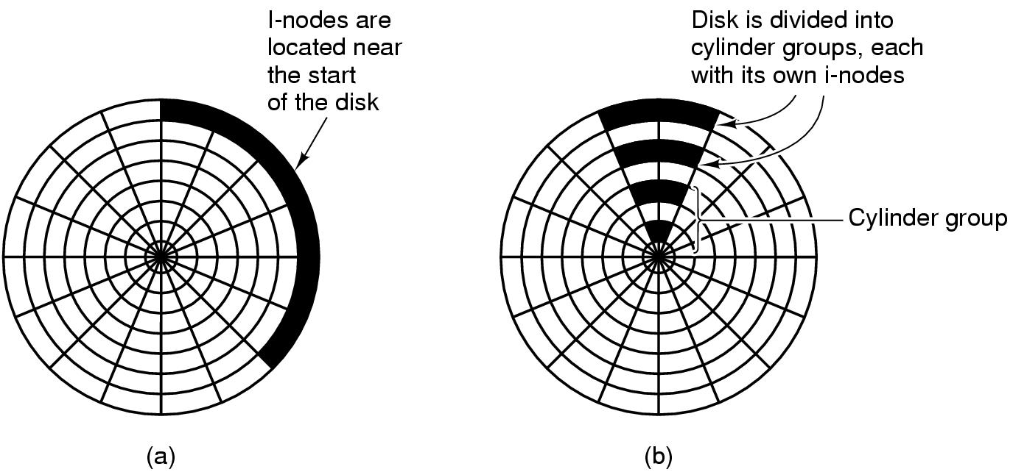
Grouping data on disk

Slide 10
Log-structured file systems
Trends in disk & memory
Faster CPUs
Larger memories
Result
More memory -> disk caches can also be larger
Increasing number of read requests can come from cache
Thus, most disk accesses will be writes
LFS structures entire disk as a log
All writes initially buffered in memory
Periodically write these to the end of the disk log
When file opened, locate i-node, then find blocks
Issue: what happens when blocks are deleted?

Slide 11
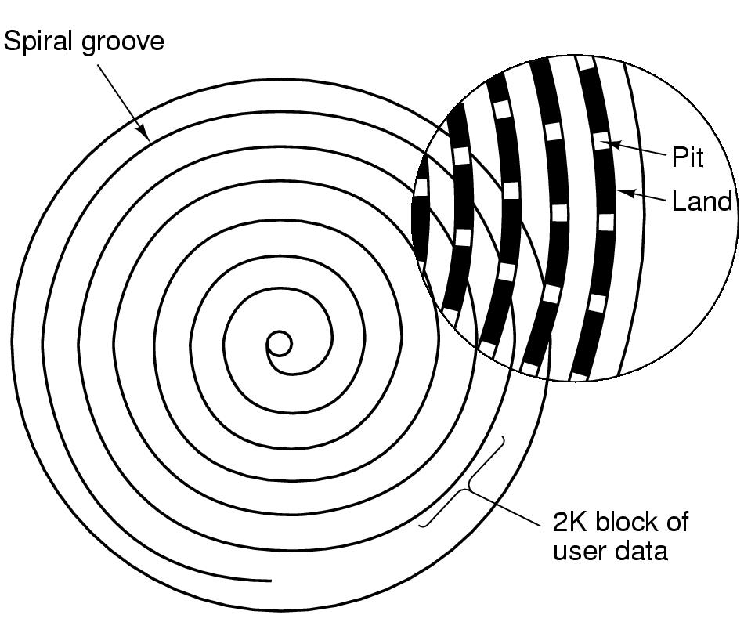
CD-ROM recording
CD-ROM has data in a spiral
Hard drives have concentric circles of data
One continuous track: just like vinyl records!
Pits & lands “simulated” with heat-sensitive material on CD-Rs and CD-RWs

Slide 12
Flash File System
Wear Leveling
Count total writes per flash sector and attempt to balance across the whole disk

Slide 13
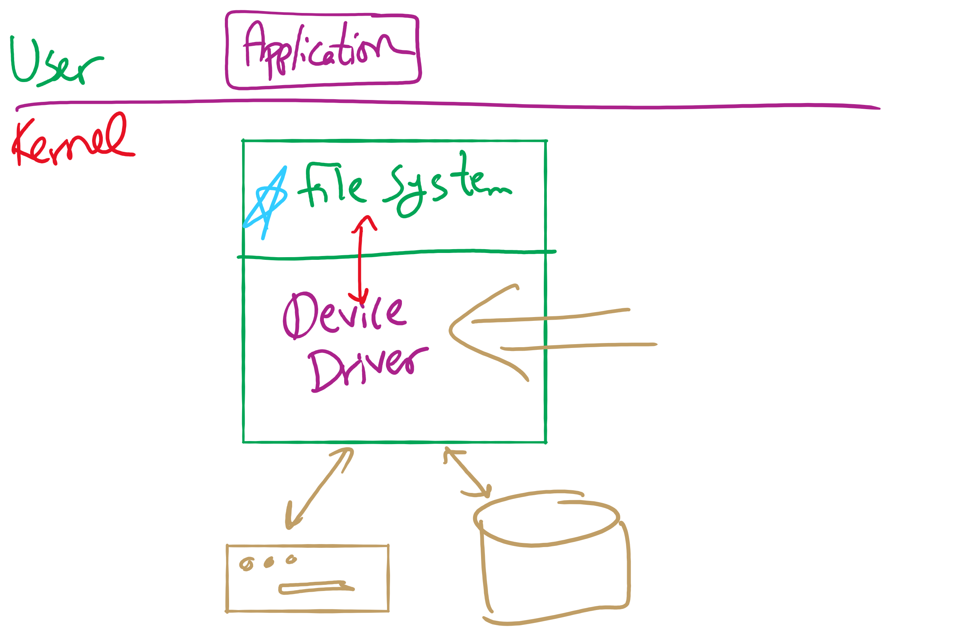
Software Stack

Slide 14
Device drivers
Device drivers go between device controllers and rest of OS
Drivers standardize interface to widely varied devices
Device drivers communicate with controllers over bus
Controllers communicate with devices themselves
User space
User program
Kernel space
Rest of the OS
Keyboard driver
Disk driver
Keyboard controller
Disk controller

Slide 15
How are I/O devices connected?
Single-bus
All memory accesses go over a shared bus
I/O and RAM accesses compete for bandwidth
Dual-bus
RAM access over high-speed bus
I/O access over lower-speed bus
Less competition
More hardware (more expensive…)
CPU
Memory
I/O
CPU
Memory
I/O
This port allows I/O devices access into memory

Slide 16
Device controllers
Electronic component controls the device
May be able to handle multiple devices
May be more than one controller per mechanical component (example: hard drive)
Controller's tasks
Convert serial bit stream to block of bytes
Perform error correction as necessary
Make available to main memory
Block Devices
A device that stores data in fixed‐sized blocks, each uniquely addressed, and can be randomly accessed
Character Devices
Device that delivers or accepts a stream of characters

Slide 17
Layers of I/O software
User-level I/O software & libraries
User
Device-independent OS software
Operating system (kernel)
Device drivers
Interrupt handlers
Hardware

Slide 18
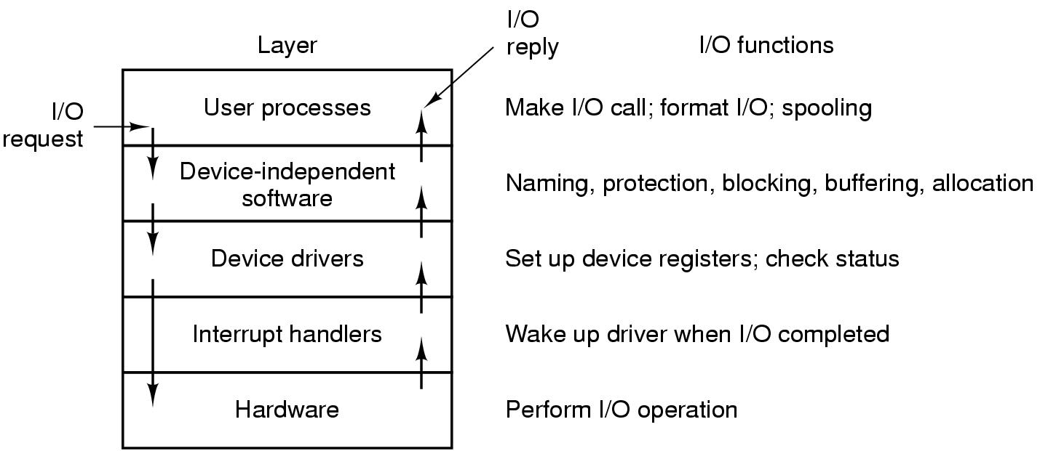
Anatomy of an I/O request

Slide 19
Device Driver goals
Device independence
Programs can access any I/O device
No need to specify device in advance
Uniform naming
Name of a file or device is a string or an integer
Doesn’t depend on the machine (underlying hardware)
Error handling
Done as close to the hardware as possible
Isolate from higher-level software
Synchronous vs. asynchronous transfers
Blocked transfers vs. interrupt-driven
Buffering
Data coming off a device cannot be stored in final destination
Sharable vs. dedicated devices

Slide 20
Memory-Mapped vs. separate I/O Space
Memory
0xFFF…
I/O ports
0
Separate I/O & memory space
Memory-mapped I/O
Hybrid: both memory-mapped & separate spaces

Slide 21
Example: Dynamic Frequency on XScale

Slide 22
Programmed I/O example: printing a page
User
Printed page
Printed page
Printed page
ABCD EFGH
ABCD EFGH
ABCD EFGH
A
AB
Kernel
ABCD EFGH
ABCD EFGH

Slide 23
Polling
copy_from_user (buffer, p, count); // copy into kernel buffer
for (j = 0; j < count; j++) { // loop for each char
while (*printer_status_reg != READY)
; // wait for printer to be ready
*printer_data_reg = p[j]; // output a single character
}
return_to_user();

Slide 24
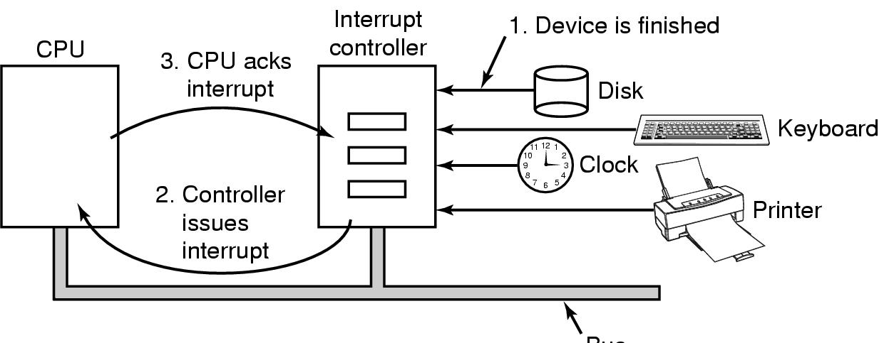
Hardware’s view of interrupts
Bus

Slide 25
Interrupt-driven I/O
copy_from_user (buffer, p, count);
j = 0;
enable_interrupts();
while (*printer_status_reg != READY)
;
*printer_data_reg = p[0];
scheduler(); // and block user
Code run by system call
if (count == 0) {
unblock_user();
} else {
j++;
*printer_data_reg = p[j];
count--;
}
acknowledge_interrupt();
return_from_interrupt();
Code run at interrupt time
(Interrupt handler)

Slide 26
What happens on an interrupt
Set up stack for interrupt service procedure
Ack interrupt controller, reenable interrupts
Copy registers from where saved
Run service procedure
(optional) Pick a new process to run next
Set up MMU context for process to run next
Load new process' registers
Start running the new process

Slide 27
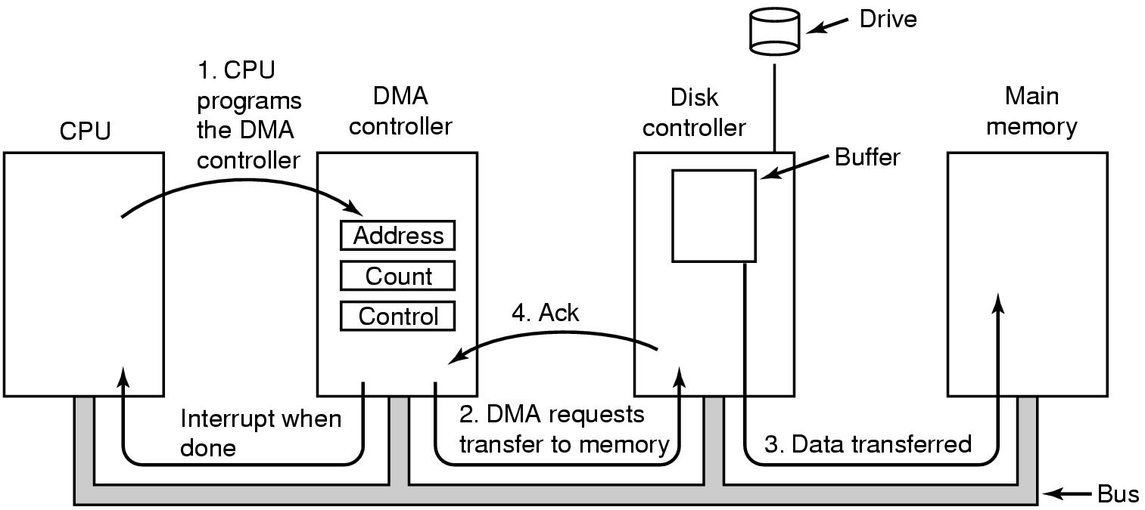
Direct Memory Access (DMA) operation

Slide 28
I/O using DMA
copy_from_user (buffer, p, count);
set_up_DMA_controller();
scheduler(); // and block user
Code run by system call
acknowledge_interrupt();
unblock_user();
return_from_interrupt();
Code run at interrupt time

Slide 29
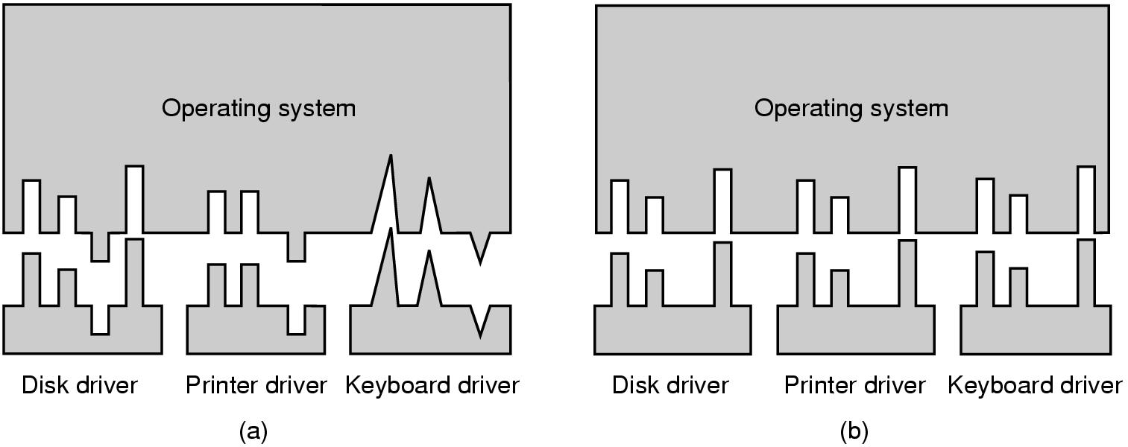
Why a standard driver interface?
Non-standard driver interfaces
Standard driver interfaces

Slide 30
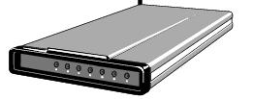
Buffering device input
User space
User space
User space
User space
Kernel space
Kernel space
Kernel space
Kernel space
2
2
1
1
3
Unbuffered input
Buffering in user space
Buffer in kernel Copy to user space
Double buffer in kernel

Slide 31
Disk drive structure
Data stored on surfaces
Up to two surfaces per platter
One or more platters per disk
Data in concentric tracks
Tracks broken into sectors
256B-1KB per sector
Cylinder: corresponding tracks on all surfaces
Data read and written by heads
Actuator moves heads
Heads move in unison
head
sector
platter
track
cylinder
surfaces
spindle
actuator

Slide 32
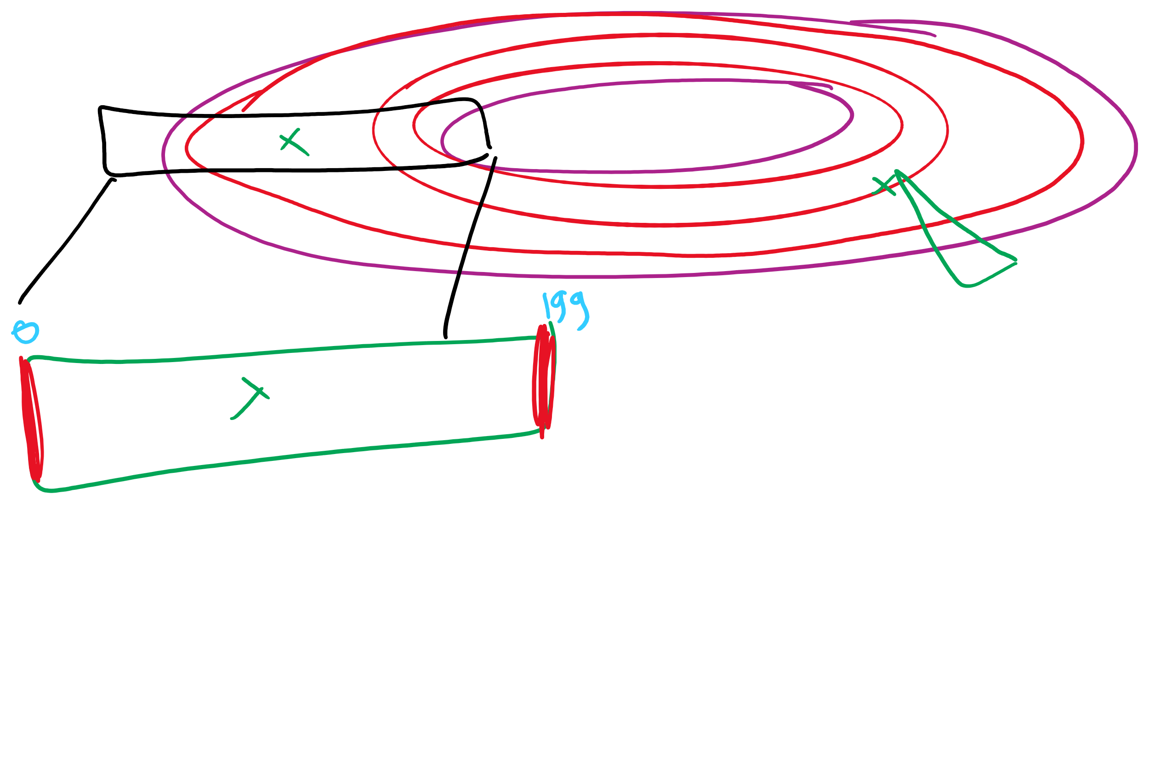
Disk scheduling algorithms
Schedule disk requests to minimize disk seek time
Seek time increases as distance increases (though not linearly)
Minimize seek distance -> minimize seek time
Disk seek algorithm examples assume a request queue & head position (disk has 200 cylinders)
Queue = 100, 175, 51, 133, 8, 140, 73, 77
Head position = 63
Outside edge
Inside edge
8
51
73
100
133
175
77
140
read/write head position
disk requests
(cylinder in which block resides)

Slide 33
First-Come-First Served (FCFS)
Requests serviced in the order in which they arrived
Easy to implement!
May involve lots of unnecessary seek distance
Seek order = 100, 175, 51, 133, 8, 140, 73, 77
Seek distance = (100-63) + (175-100) + (175-51) + (133-51) + (133-8) + (140-8) + (140-73) + (77-73) = 646 cylinders
read/write head start
100
175
51
133
8
140
73
77

Slide 34
Shortest Seek Time First (SSTF)
Service the request with the shortest seek time from the current head position
Form of SJF scheduling
May starve some requests
Seek order = 73, 77, 100, 133, 140, 175, 51, 8
Seek distance = 10 + 4 + 23 + 33 + 7 + 35 + 124 + 43 = 279 cylinders
read/write head start
73
77
51
8
133
100
140
175

Slide 35
SCAN (elevator algorithm)
Disk arm starts at one end of the disk and moves towards the other end, servicing requests as it goes
Reverses direction when it gets to end of the disk
Also known as elevator algorithm
Seek order = 51, 8, 0 , 73, 77, 100, 133, 140, 175
Seek distance = 12 + 43 + 8 + 73 + 4 + 23 + 33 + 7 + 35 = 238 cyls
read/write head start
51
8
73
77
100
133
140
175

Slide 36
C-SCAN
Identical to SCAN, except head returns to cylinder 0 when it reaches the end of the disk
Treats cylinder list as a circular list that wraps around the disk
Waiting time is more uniform for cylinders near the edge of the disk
Seek order = 73, 77, 100, 133, 140, 175, 199, 0, 8, 51
Distance = 10 + 4 + 23 + 33 + 7 + 35 + 24 + 199 + 8 + 43 = 386 cyls
read/write head start
73
77
100
133
140
175
8
51

Slide 37
C-LOOK
Identical to C-SCAN, except head only travels as far as the last request in each direction
Saves seek time from last sector to end of disk
Seek order = 73, 77, 100, 133, 140, 175, 8, 51
Distance = 10 + 4 + 23 + 33 + 7 + 35 + 167 + 43 = 322 cylinders
read/write head start
73
77
100
133
140
175
8
51

